Slide 1
Python Basics
Operators, Data Types, Control Statements, Loops & Functions

Slide 2
Operators
Arithmetic Operators: used for mathematical calculations.
+ (Addition)
- (Subtraction)
* (Multiplication)
/ (Division)
// (Floor division)
% (Modulo)
** (Exponentiation)

Slide 3
Operators
Comparison Operators: used to compare values.
== (Equal to)
!= (Not equal to)
> (Greater than)
< (Less than)
>= (Greater than or equal to)
<= (Less than or equal to)

Slide 4
Operators
Logical Operators: used to combine conditional statements.
and (Logical AND)
or (Logical OR)
not (Logical NOT)

Slide 5
Operators
Identity Operators: used to compare the memory locations of objects.
is Returns True if both variables are the same object
is not Returns True if both variables are not the same object

Slide 6
Operators
Membership Operators: used to check if a value is part of a sequence.
in Returns True if a value is found in the sequence
not in Returns True if a value is not found in the sequence

Slide 7
Operators
Bitwise Operators: used to manipulate individual bits of data.
& (Bitwise AND)
| (Bitwise OR)
^ (Bitwise XOR)
~ (Bitwise NOT)
<< (Left shift)
>> (Right shift)

Slide 8
Data Types
Numeric: int, float, complex
String (str)
Boolean (bool)
None
Data structures: list, tuple, dictionary, set, etc.

Slide 9
Input & Output in Python
[Input: reading values from the user, e.g. input()]
[Output: displaying results, e.g. print()]

Slide 10
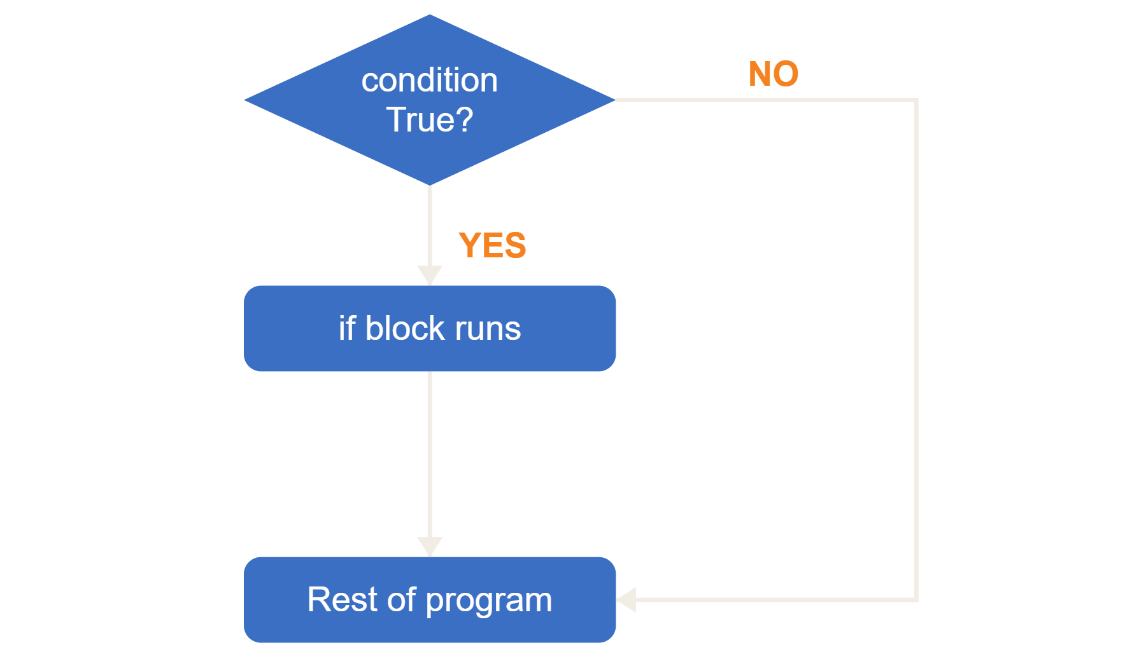
1. if Statement
Executes a block of code only when a specified condition is True.
if condition:
# Code to execute

Slide 11
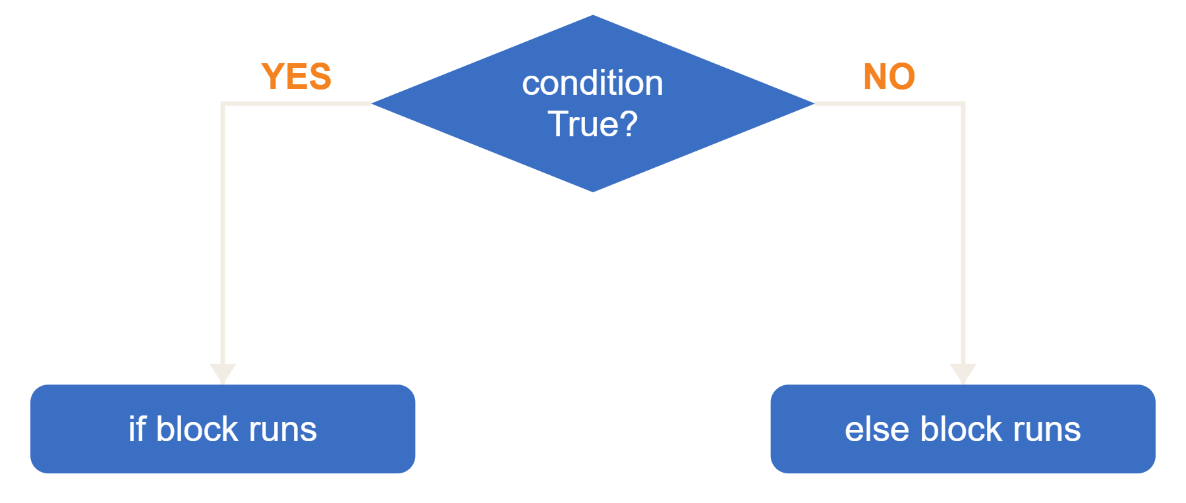
2. if-else Statement
Executes one block of code if the condition is True and another block if it is False.
if condition:
# Code if condition is True
else:
# Code if condition is False

Slide 12
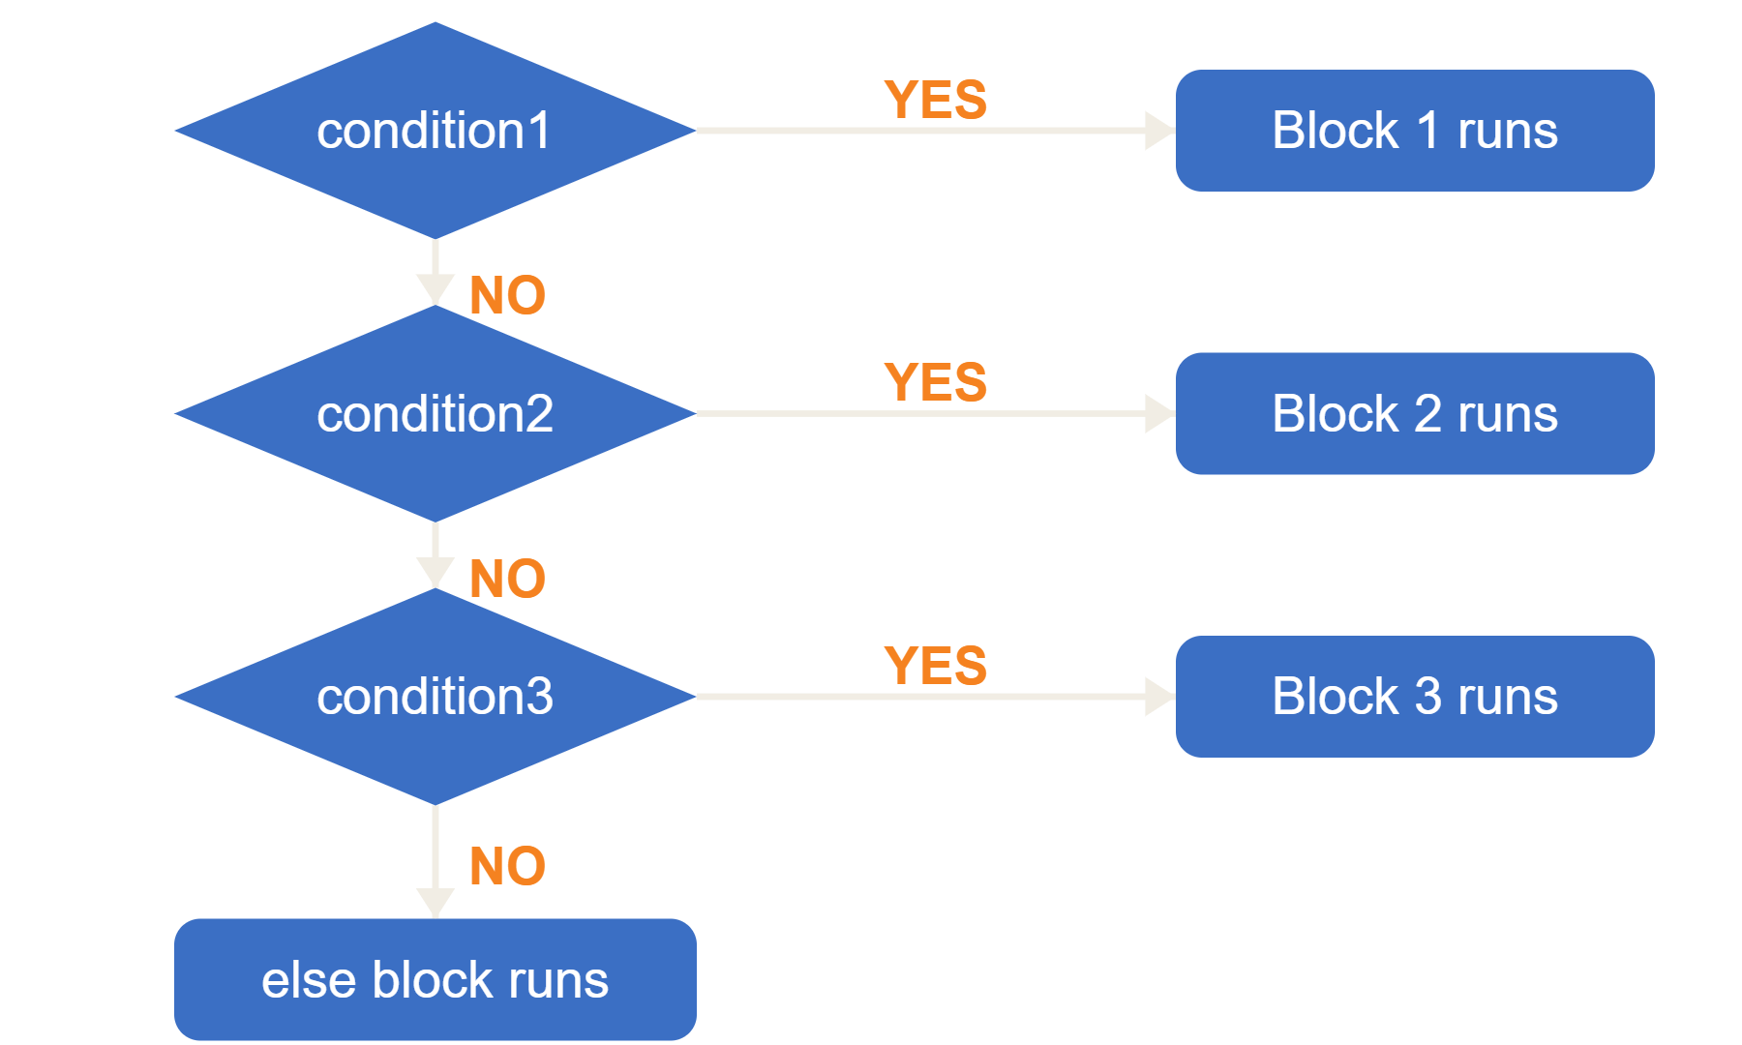
3. if-elif-else Statement
Checks multiple conditions and runs the block of the first True condition. The else block runs if none is True.
if condition1:
# Code for condition1
elif condition2:
# Code for condition2
elif condition3:
# Code for condition3
else:
# Code if no condition is True

Slide 13
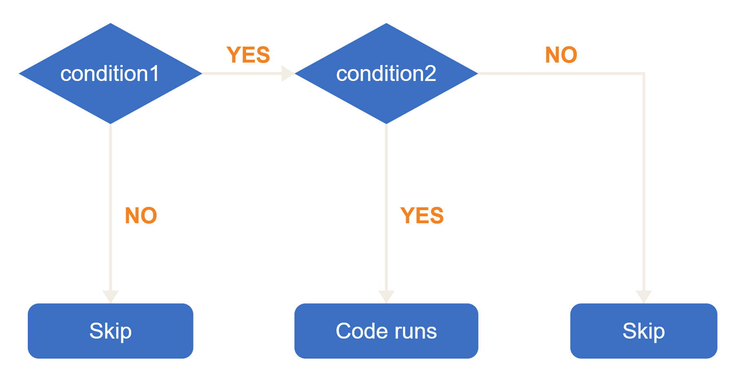
4. Nested if Statement
An if statement placed inside another if statement, used when a decision depends on another condition.
if condition1:
if condition2:
# Code if both
# conditions are True

Slide 14
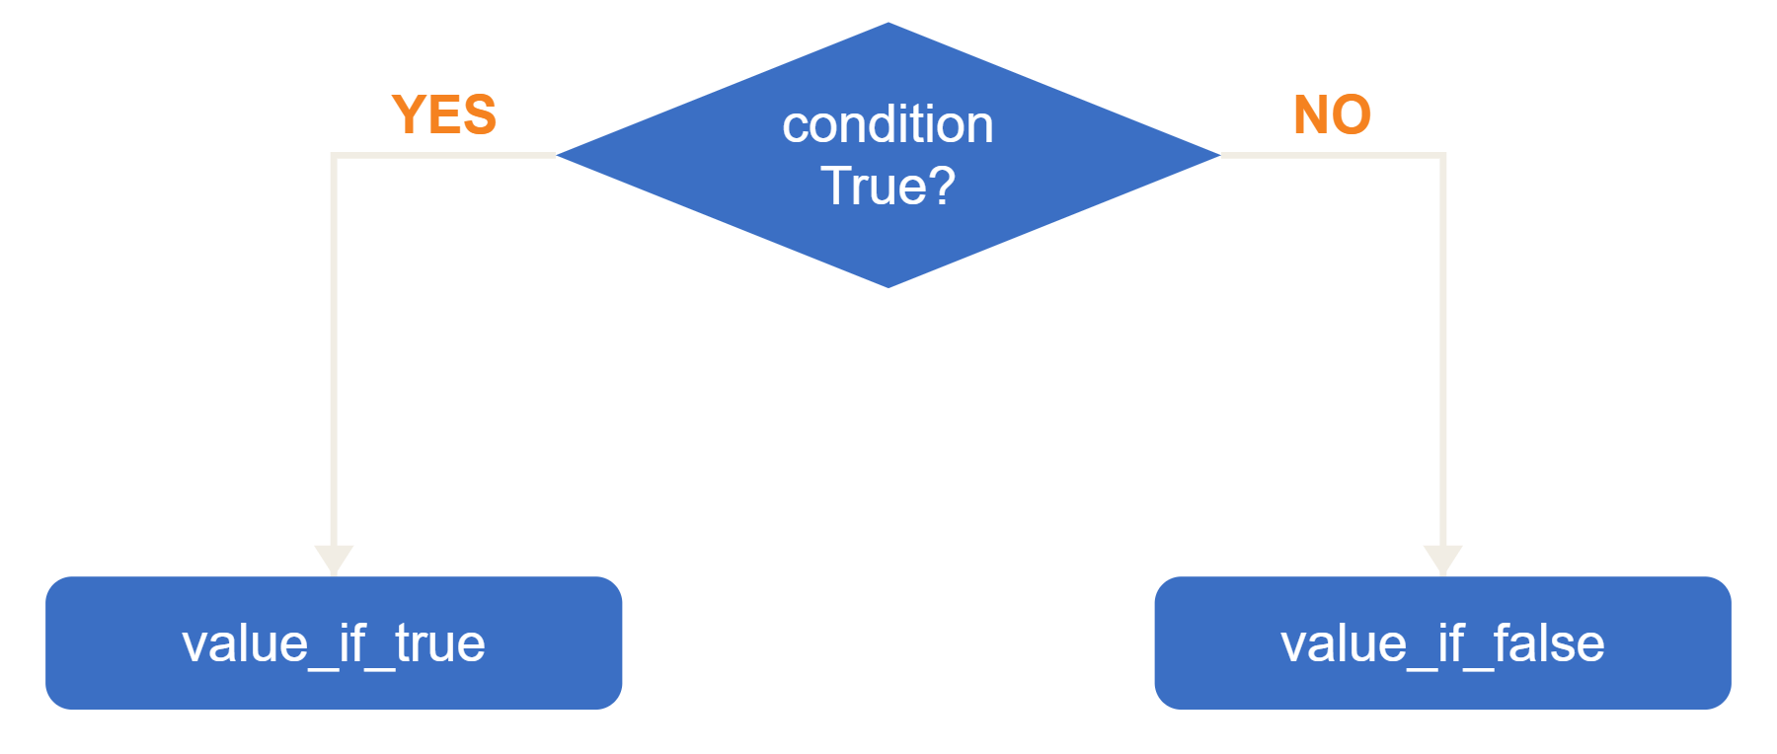
5. Ternary Operator
A one-line conditional expression (conditional expression) that returns one value if a condition is True and another if it is False.
value_if_true
if condition
else value_if_false

Slide 15
Loops
for
while

Slide 16
Functions
def functionName(parameters):

Slide 17
Thank You
Q&A

